Slide 1
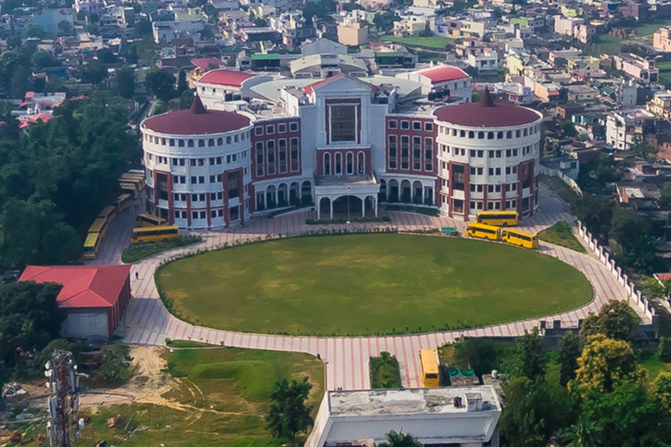
Graphic Era Hill University MCA (2019 - 2022)

Slide 2
Final Semester Project
Disease Prediction Using Machine learning

Slide 3
Disease Prediction Using Machine learning
Guidance: Ms Poonam Verma (Assistance professor)
Contributors:
Rahul Rawat (1901017)
Rohit Nautiyal (1901019)

Slide 4
Agenda
Problem Statement
Interface
Show Model response
Technology used in this Project
Project Demo Section

Slide 5
Section 1
Problem Statement

Slide 6
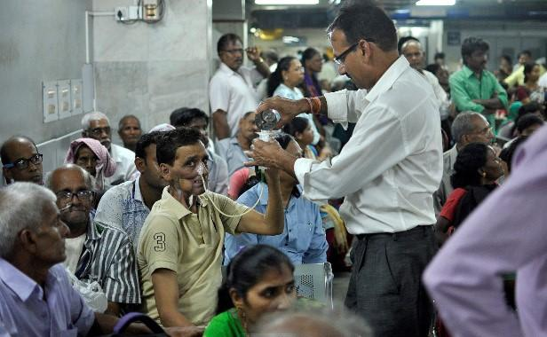
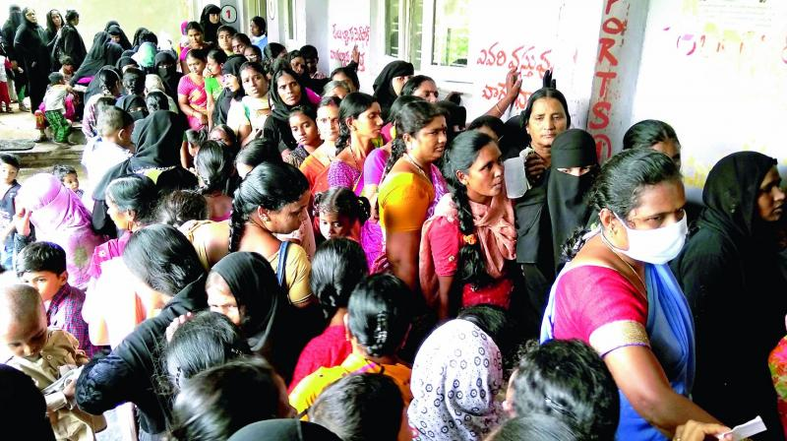
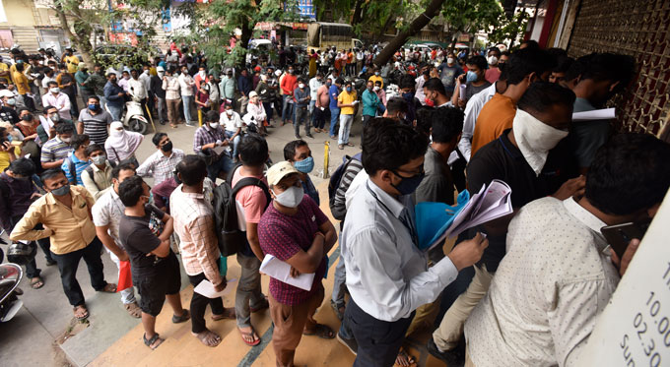

Slide 7
Section 2
Interface

Slide 8
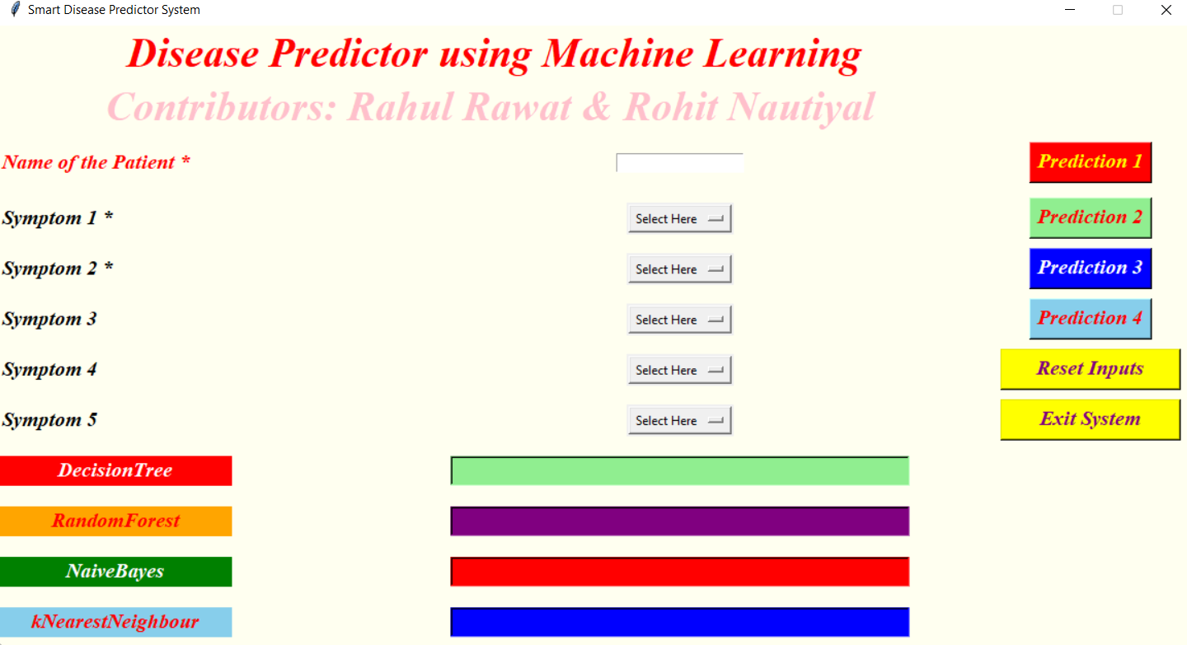

Slide 9
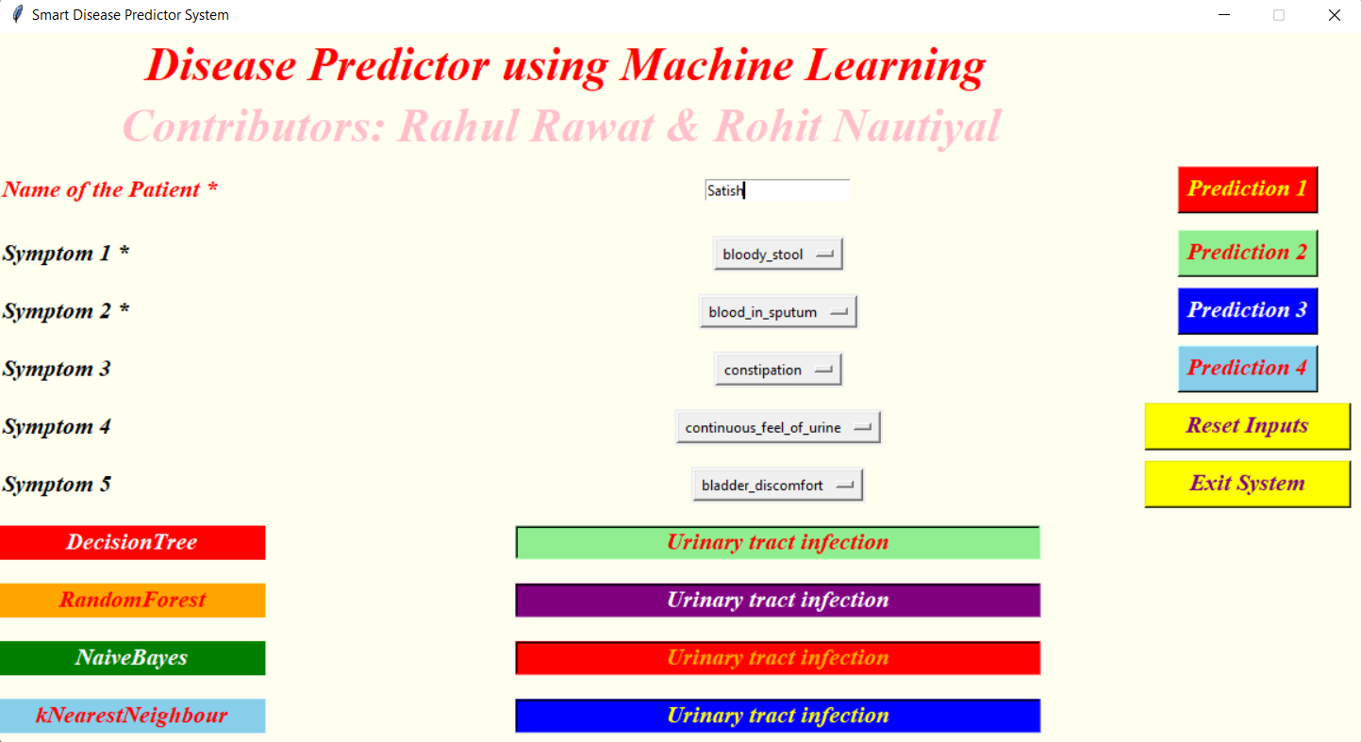

Slide 10
Section 7
Technology used in this Project

Slide 11
Python 3 SQLite Jupyter Notebook(Anaconda 3) Machine Learning Techniques

Slide 12
Project Demo

Slide 13
Questions & Answers

Slide 14
Thank You

